Slide 1
Capstone Project
Airbnb Booking Analysis Name: Md Sohail Tanveer

Slide 2
Table of Content
Objective of EDA
Business Context
Data description
Libraries used
Project architecture
Exploratory Data Analysis
Challenges and Recommendation
Conclusion

Slide 3
Objective of EDA(Exploratory Data Analysis)
Importance of using EDA for analyzing data sets is:
Helps identify errors in data sets.
Gives a better understanding of the data set.
Helps detect outliers or anomalous events.
Helps understand data set variables and the relationship among them.

Slide 4
Business Context
Since 2008, guests and hosts have used Airbnb to expand on traveling possibilities and present a more unique, personalized way of experiencing the world.
Today, Airbnb became one of a kind service that is used and recognized by the whole world. Data analysis on millions of listings provided through Airbnb is a crucial factor for the company.
These millions of listings generate a lot of data – data that can be analyzed and used for security, business decisions, understanding of customers’ and providers’ (hosts) behavior and performance on the platform, guiding marketing initiatives, implementation of innovative additional services, and much more.

Slide 5
Data Description
This dataset has around 49,000 observations in it with 16 columns and it is a mix of categorical and numeric values.
Explore and analyze the data to discover key understandings (not limited to these) such as :
What can we learn about different hosts and areas?
What can we learn from predictions? (ex: locations, prices, reviews, etc.)
Which hosts are the busiest and why?
Is there any noticeable difference in traffic among different areas and what could be the reason for it?

Slide 6
Features Definition
id: unique id for house/apartment
Name: name of the listing house/apartment
Host_id: unique government id for each individual listing their property on Airbnb.
Host_name: name of the individual who owns or rents their house/apartment
Neighbourhood_group: clusters of neighborhoods in a particular area.
Neighbourhood: when searching for accommodation guests can filter by neighborhood attributes and explore layers of professional quality.
Latitude: latitude is the measure of the distance north or south of the equator.
Longitude: longitude is the measure of the east or west of the prime meridian.

Slide 7
Room_type: Airbnb has three types of room
Entire house/apartment
Private room
Shared room
Price: Cost of booking
Minimum_nights: it’s the condition while booking, you have to pay for minimum nights whether you stay or not.
Number_of_reviews: total number of reviews of the host submitted by the guest.
Last_review: latest review submitted by guest as feedback
Review_per_month: number of reviews received by host per month.
Calculated_host_listing_count: total number of listing by a host.
Availability_365: indicate the total number of days the listing is available in a year.

Slide 8
Main libraries used:
Pandas for data manipulation and aggregation
NumPy for computationally efficient operation
Matplotlib and Seaborn for visualization and behavior with respect to the target variable.
Folium used for map generation using latitude and longitude.

Slide 9
Pre-Processing
Mounting drive
Importing important libraries
Loading dataset
Checking for NULL values
Handling NULL Values

Slide 10
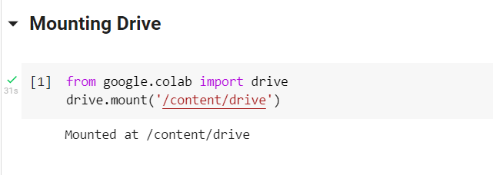
Mounting Drive
We mount the drive so that we can import our data set from google drive easily, It can be done by the two lines of code given below.

Slide 11
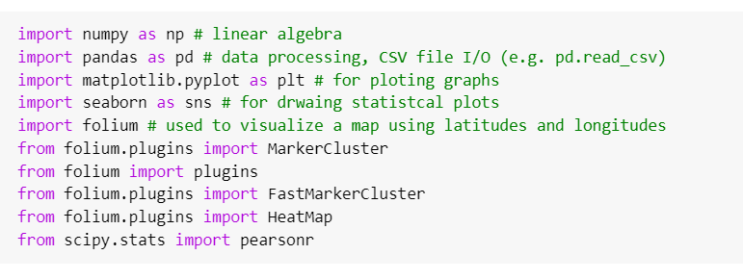
Importing Libraries
Importing Libraries is the most important part of preprocessing because it helps in structuring your code effectively.

Slide 12
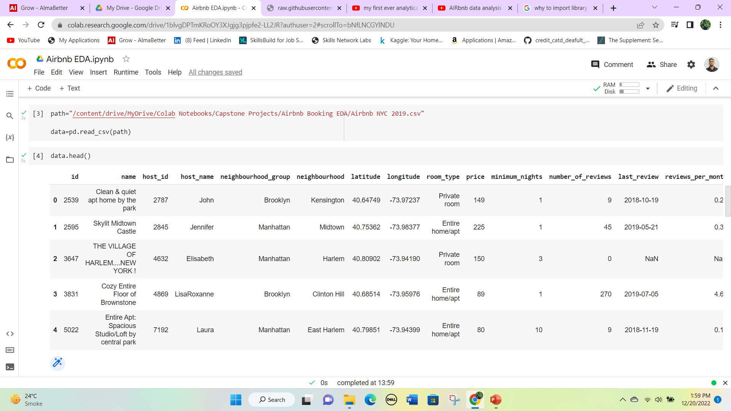
Loading Dataset
First we copy the path of the dataset from google drive and then stored it in a variable called path.
Now we use the second line of code to load the dataset.

Slide 13
Dataset preview
Using the .head( ) method we will see the first five observations of the dataset.

Slide 14
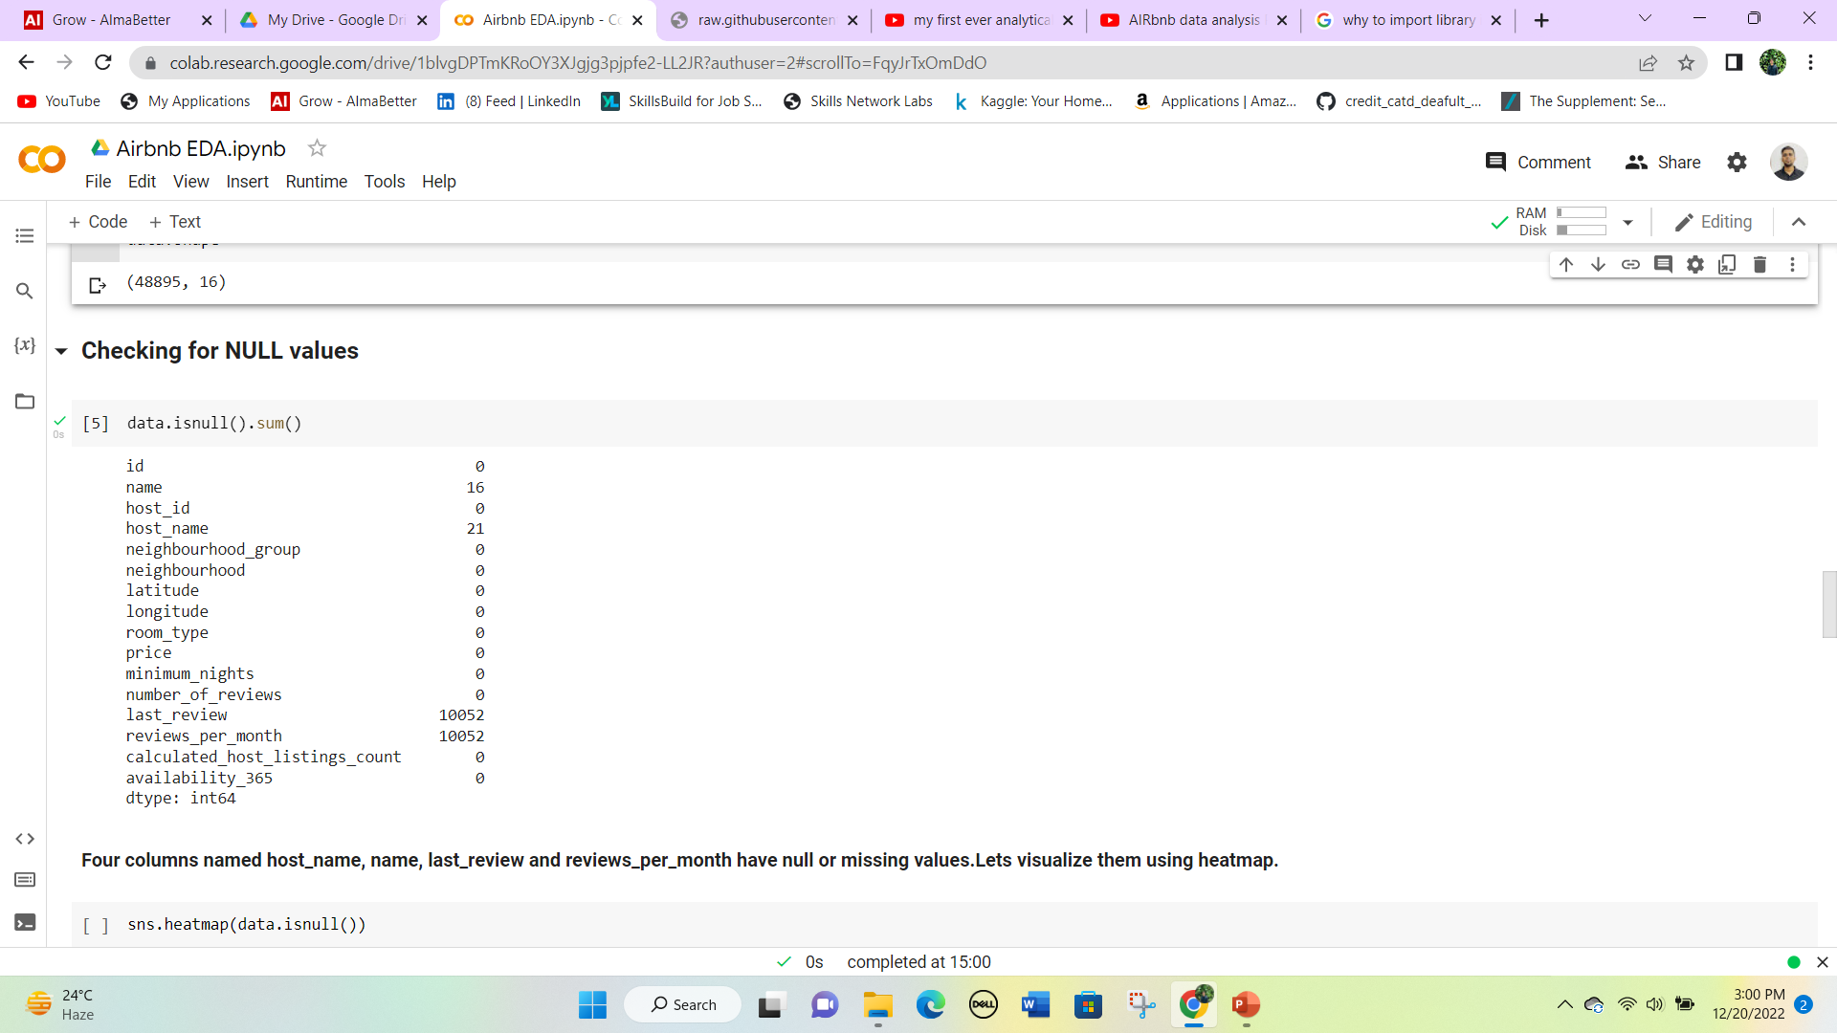
Checking NULL values
Only four columns contain the null values name, host_name, last_review and reviews_per_month
We can replace null values in reviews_per_month with 0.
In column last review it’s a date and the null values are more than 10,000, so we should also replace it with 0 because we don’t know the specific date of the last review.

Slide 15
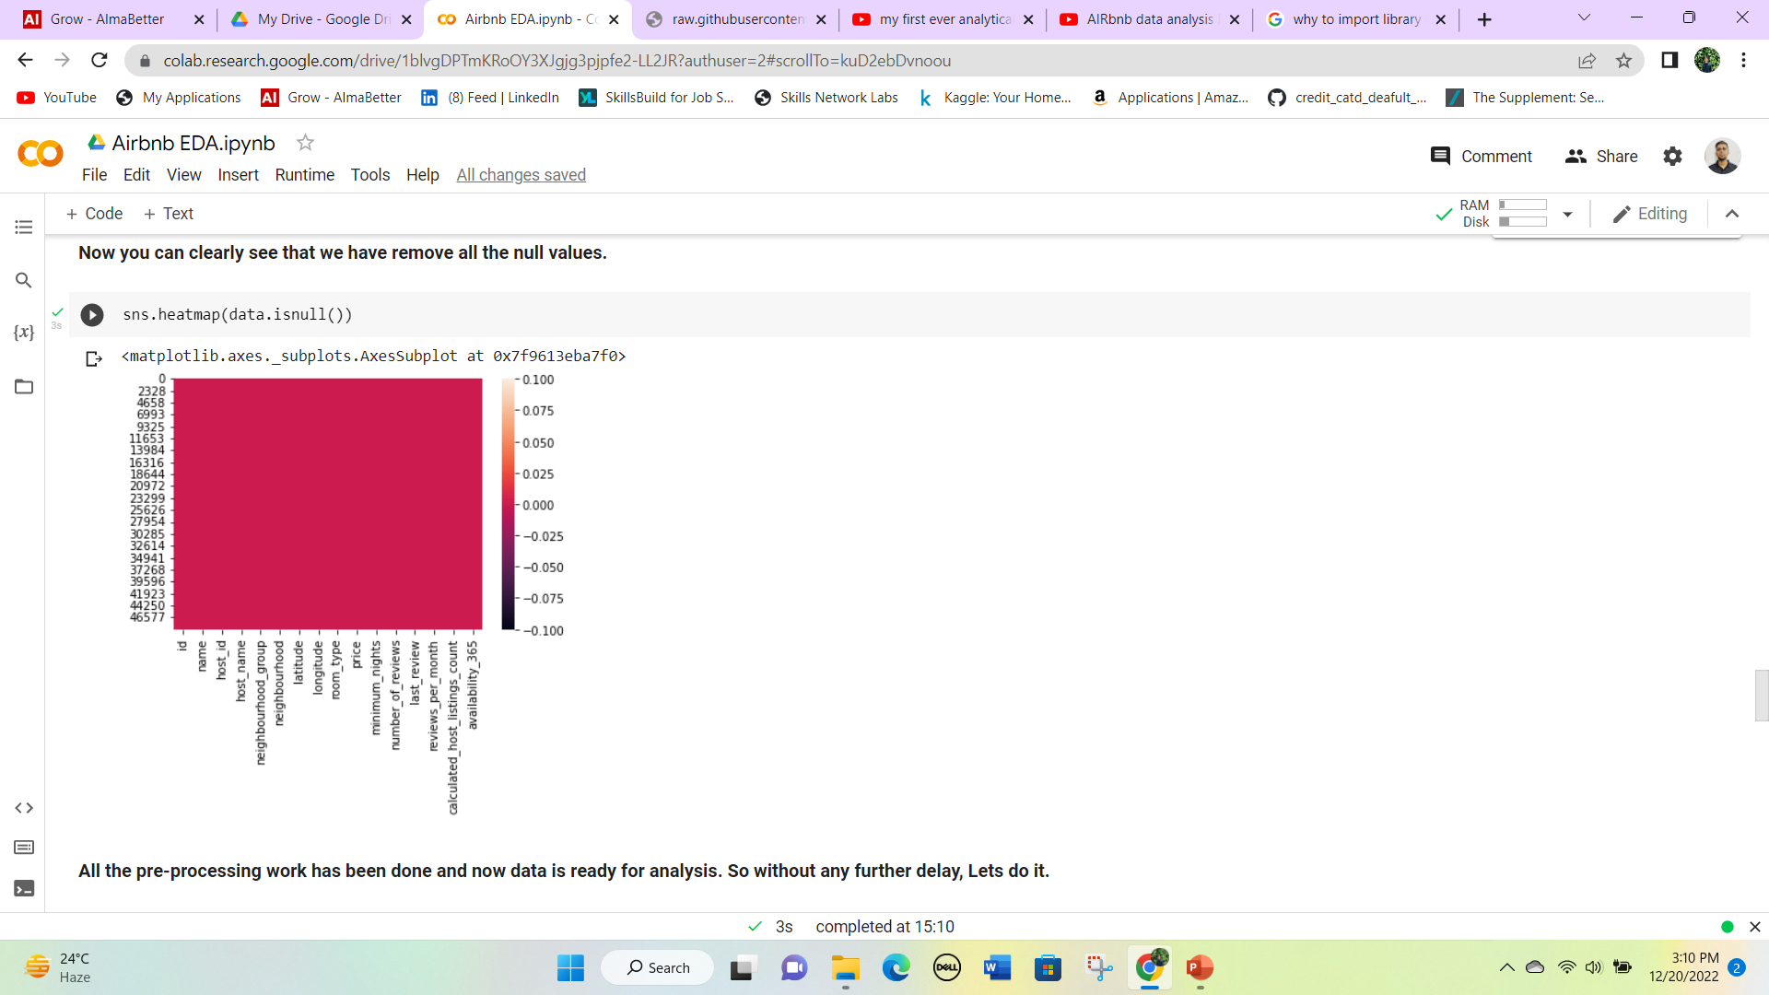
Continued
Since null values in columns name and host_name are very less, so we can drop the observation.
Now let’s visualize the null values of the dataset using a heatmap.
All the pre-processing work has been done and now the data is ready for analysis.

Slide 16
Exploratory Data Analysis:
Feature Analysis
Statistical Analysis
Price Analysis
Host Analysis
Neighborhood and Neighborhood group Analysis
Reviews Analysis
Location and Room type Analysis

Slide 17
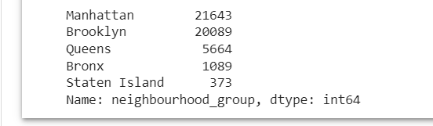
1. Feature Analysis:
let’s start with analyzing the most important categorical variables i.e. neighbourhood_group, room_type, and neighbourhood.
There are five unique values for the categorical column neighbourhood_group i.e. Brooklyn, Manhattan, Queens, Staten Island, and Bronx. The values counts of each neighbourhood_group are given below.
Most of the bookings are done in Manhattan and Brooklyn which is around 80% time.

Slide 18
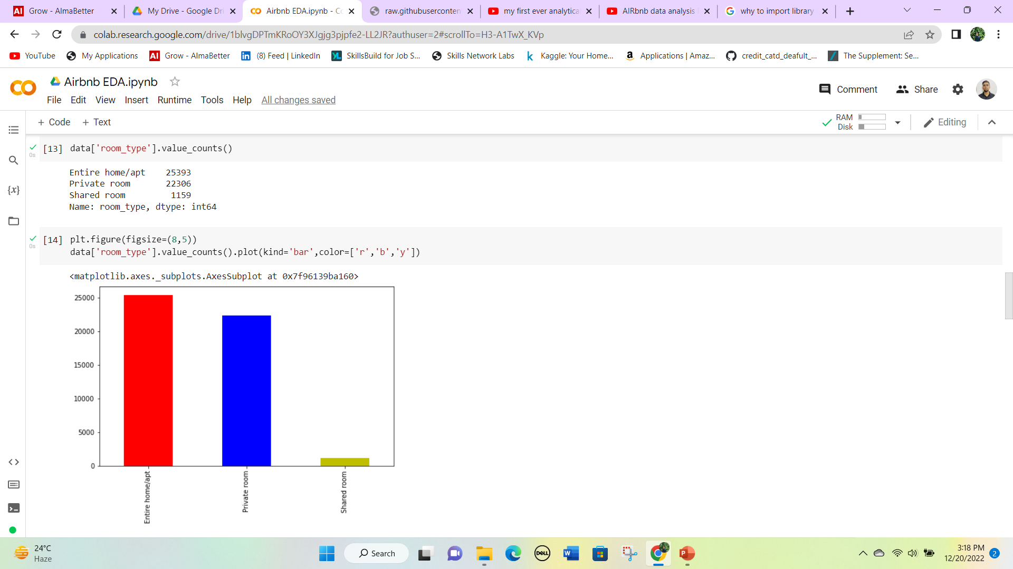
There are only three types of rooms i.e. Private room, Entire home/ apt and shared room.
The values count of each room type is given below.
We can clearly see that customers prefer either an Entire room/ apt or a Private room.
Let’s visualize it using a bar graph.

Slide 19
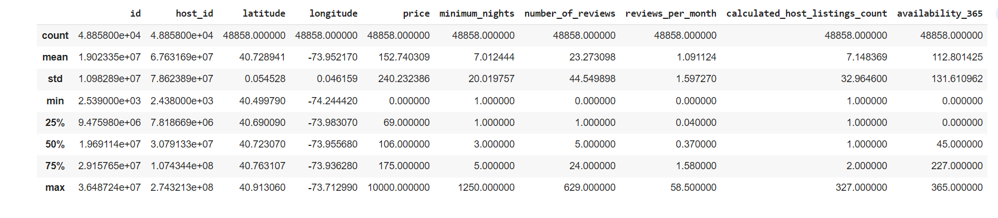
2. Statistical Analysis
We can clearly see that the minimum price is 0, which is surprising as a price of 0 doesn’t make sense to do business. So we will fill those zero values with median values according to the room type.

Slide 20
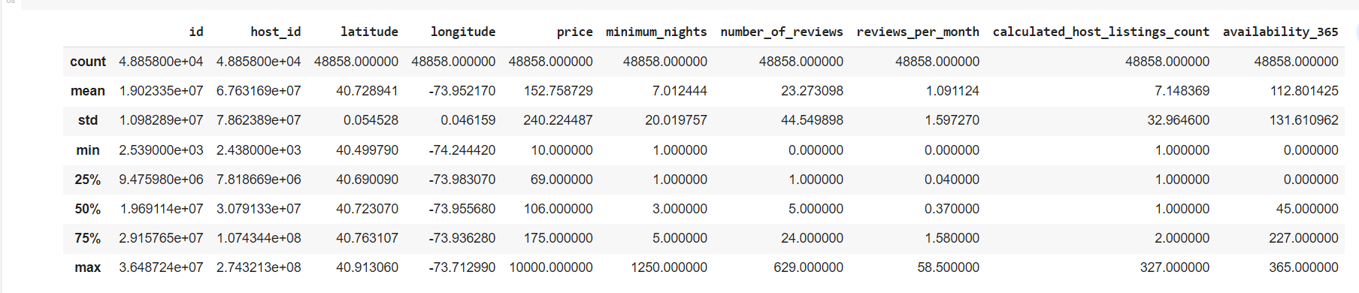
Continued
NOTE: We can notice that we have successfully updated the price column where we have values as 0, So now the minimum value now is $10. But the availability_365 column still has a minimum value of 0 as well 25 percentile is 0.
After checking we found that almost 36% of data having availability days 0 is a bit shocking, If you have a business providing rooms for Airbnb and your availability is 0 days that is an extreme case. But here 36% data has availability days is 0.

Slide 21
3. Price Analysis
Price has been the major factor while booking a room.
Price of room can depend on room_type, neighbourhood_group and availability of the room.
Here we will try to answer two questions based on the price column:
Average price of booking in all neighbourhood groups and in different room types.
Distribution of price using boxplot across different room types.

Slide 22
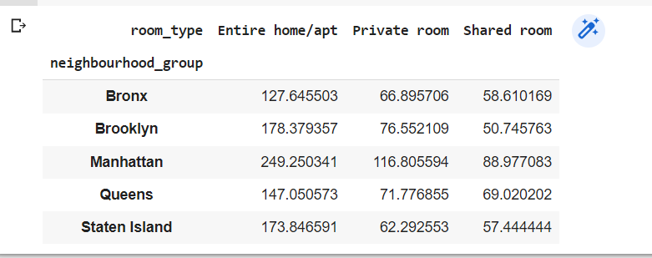
The average price of booking in all neighbourhood groups and in different room types.
Observations: As we can see Manhattan is the most costly and the Bronx is cheap for each room_type.
But I think we can make it more useful for business implementation and we can suggest this price to hosts for good business.

Slide 23
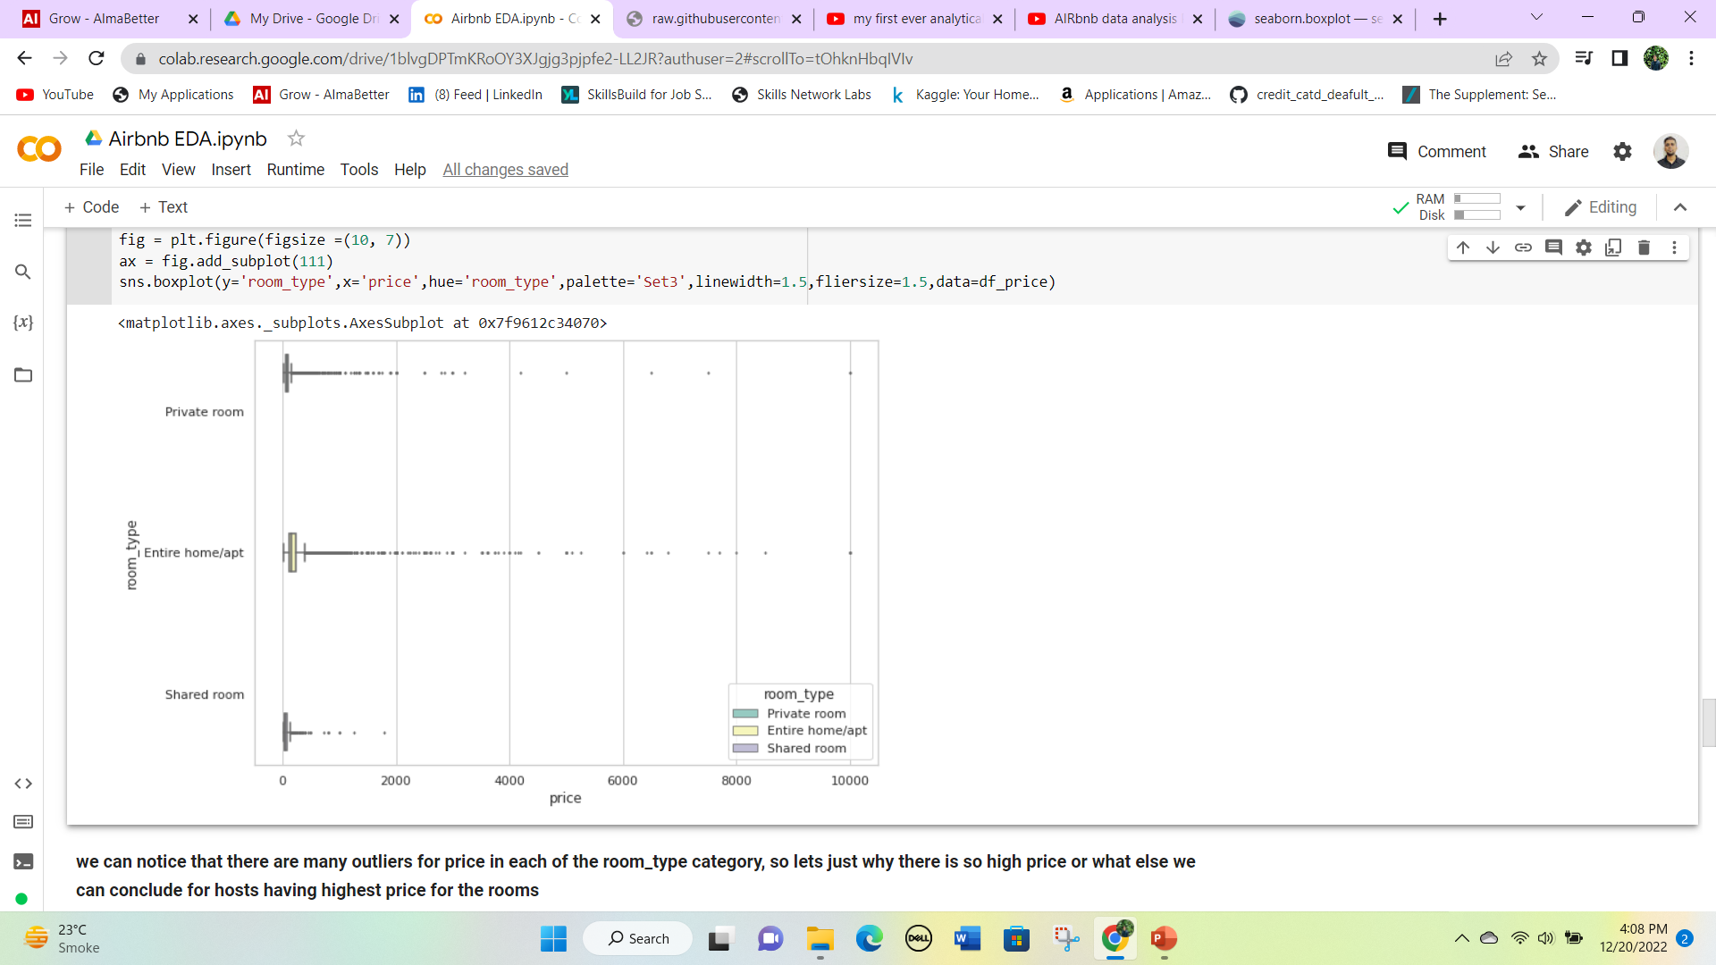
Distribution of price using boxplot across different room types.
We can notice that there are many outliers for price in each of the room_type categories, so let’s just see why there is so high price or what else we can conclude for hosts having the highest price for the rooms.
Let’s check out which host has highest price of all and we will check its rating, minimum nights availability_365, and last reviews in order to judge.

Slide 24
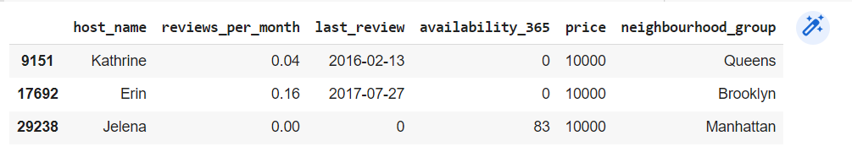
Clearly, if I would have to work at Airbnb I would have suggested the following:
1) Kathrine and Erin have the highest price but availability is zero and it can cost them in losing premium customers.
2) Katherine’s last review year is 2016 and Erin’s last year review is 2017 which is 2-3 years back (as the data was collected in 2019), which means they do not update their details frequently or they are closed now.
3) Since the price is so high for Kathrine, Erin, and Jelena’s apartments, very few people come to stay. Hence the reviews per month are also low.
4) Katherine has an apartment in the Queens neighborhood group which got very few bookings, So they should keep a moderate(average) price so that more people would visit and stay in her apartment, it would also increase her reviews per month.

Slide 25
4. Host Analysis
Hosts are the person who lists their apartment on Airbnb.
We will see which host has the most number of buildings listed on Airbnb.
Also we will find out the hosts with the most number of reviews.
At last we will check the busiest host among all.

Slide 26
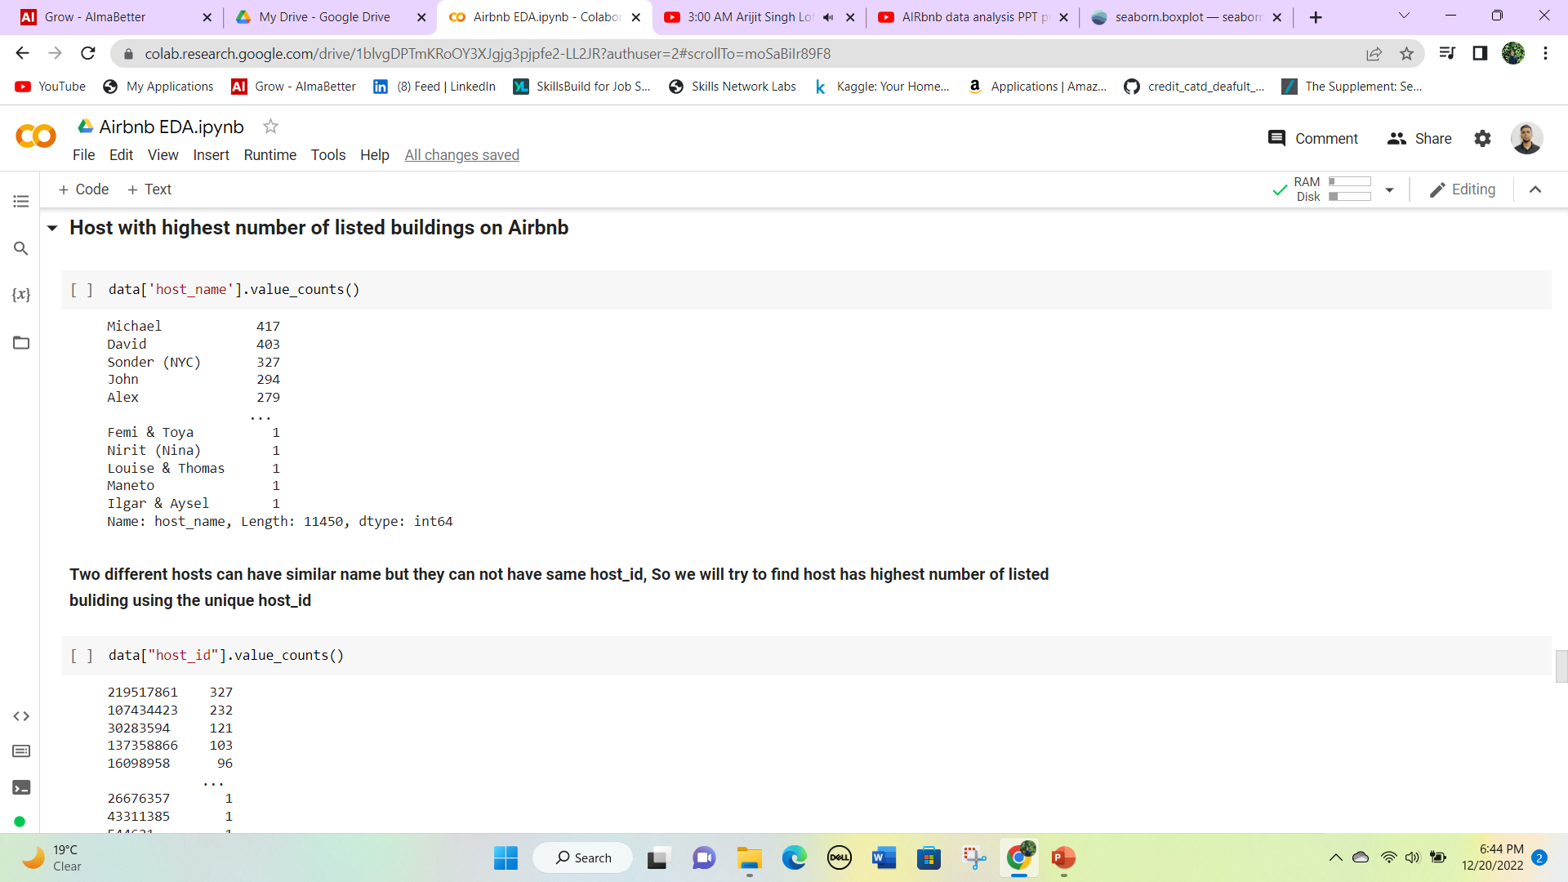
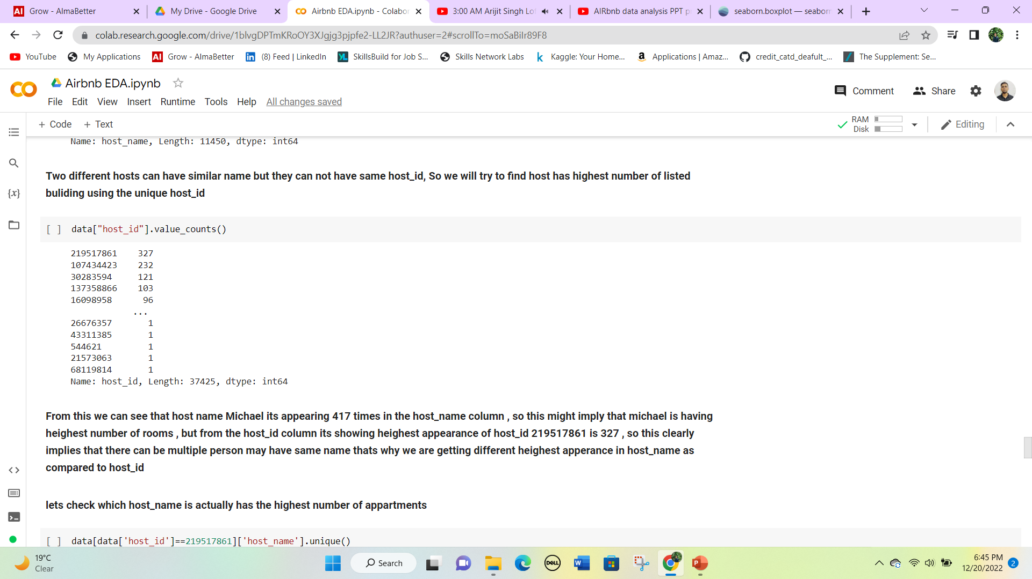
Host with most number of listed buildings on Airbnb
After doing value counts in the hostname column we found that Michael appears 417 times.
From the host_id column, it’s showing the highest appearance of host_id 219517861 is 327, so this clearly implies that there can be multiple people may have the same name that’s why we are getting different highest appearance in host_name as compared to host_id.
After checking we found that Sonder (NYC) is having the maximum number of rooms listed for the guest, For Airbnb he might be a very important person then.

Slide 27
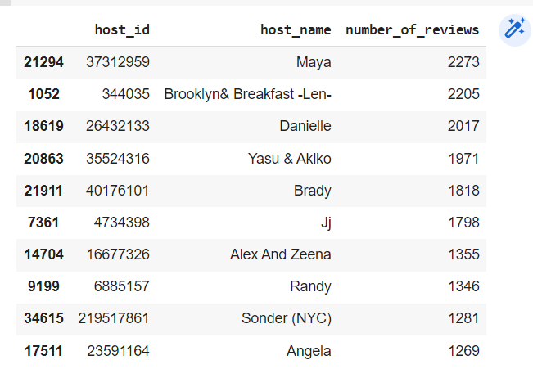
Top 10 hosts that have obtained highest no. of reviews
Maya is the most number of times rated hosts on Airbnb Customer with a total of 2273 reviews.
We can also see that Sonder(NYC) is also on the list means he has the most favorable rooms on Airbnb.

Slide 28
5. Neighbourhood and Neighbourhood group Analysis
Neigbourhood is basically the local area where apartments or buildings are available.
We will be doing the following analysis to come to some conclusion regarding the neighbourhoods:
Top 3 costly neighbourhoods in each neighbourhood_group.
Top 10 neighbourhoods which have the maximum number of listed rooms/buildings on Airbnb.
Distribution of each room type in different neighbourhood_group.

Slide 29
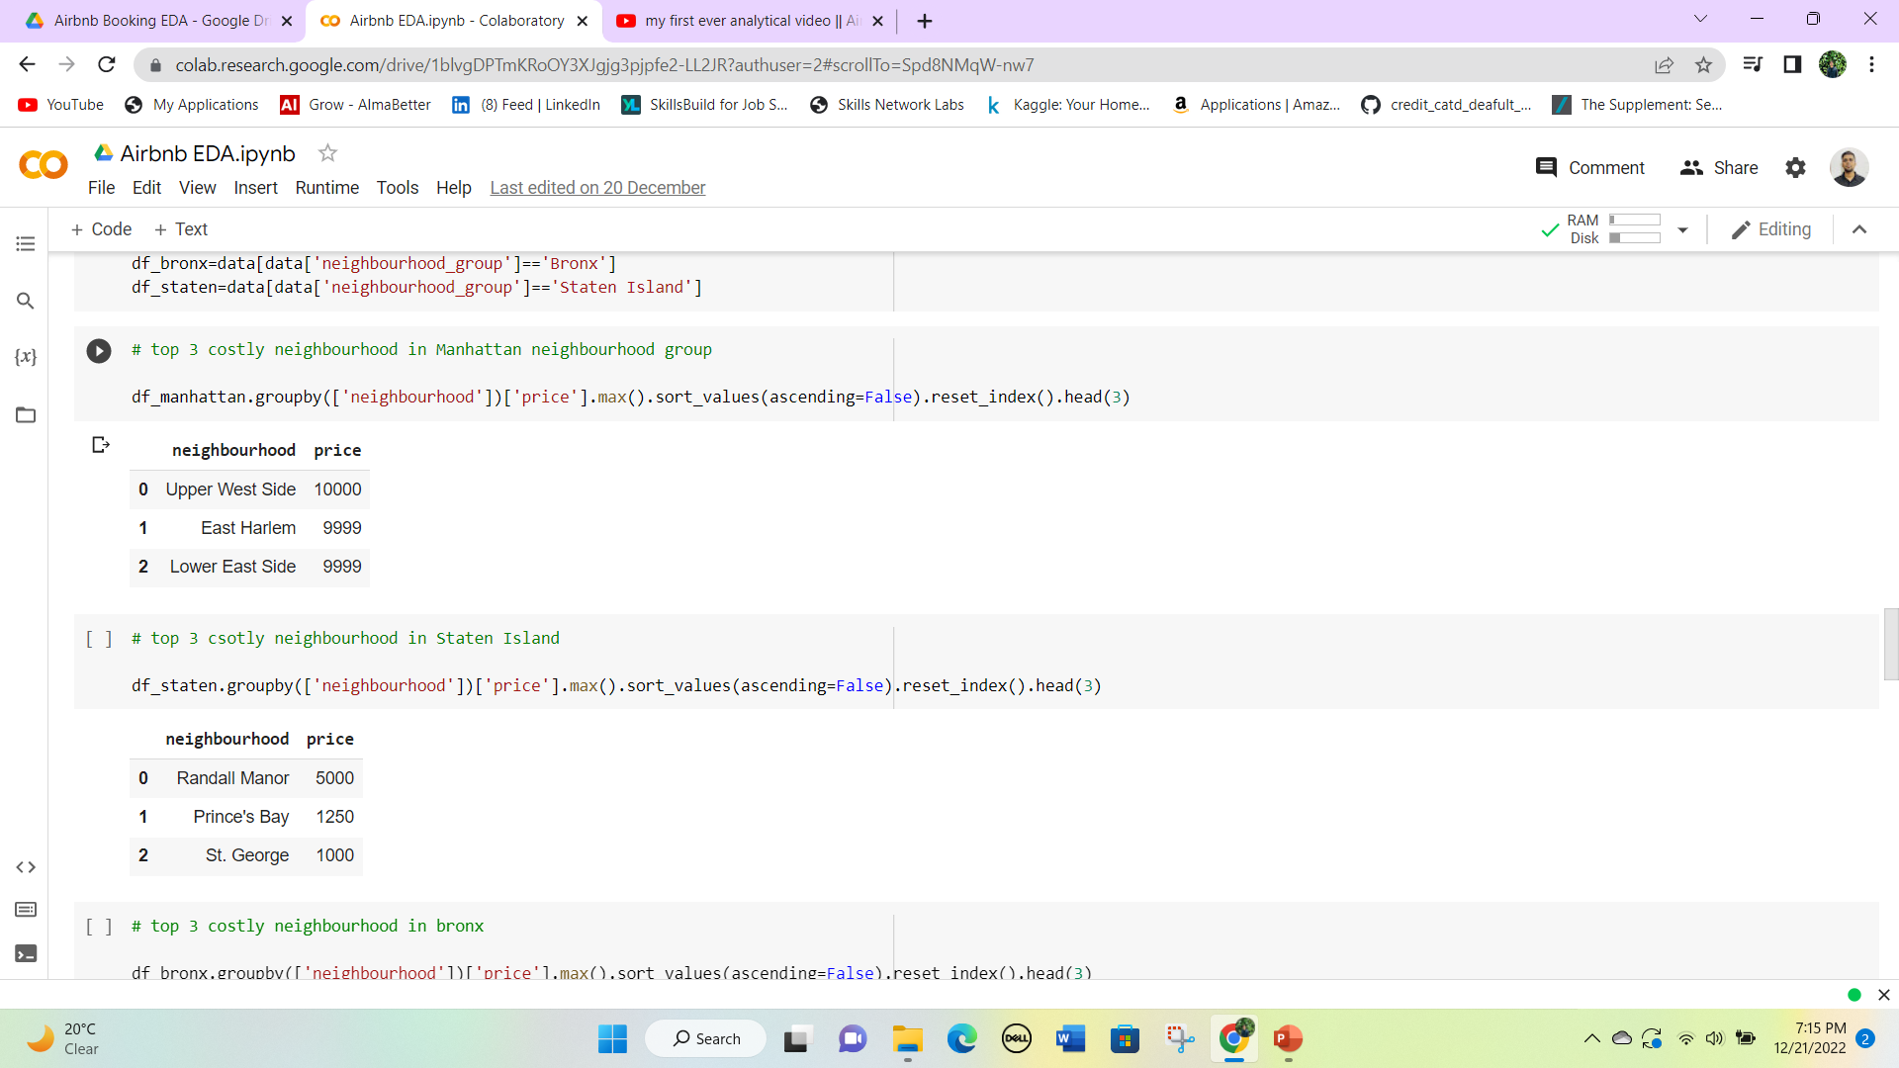
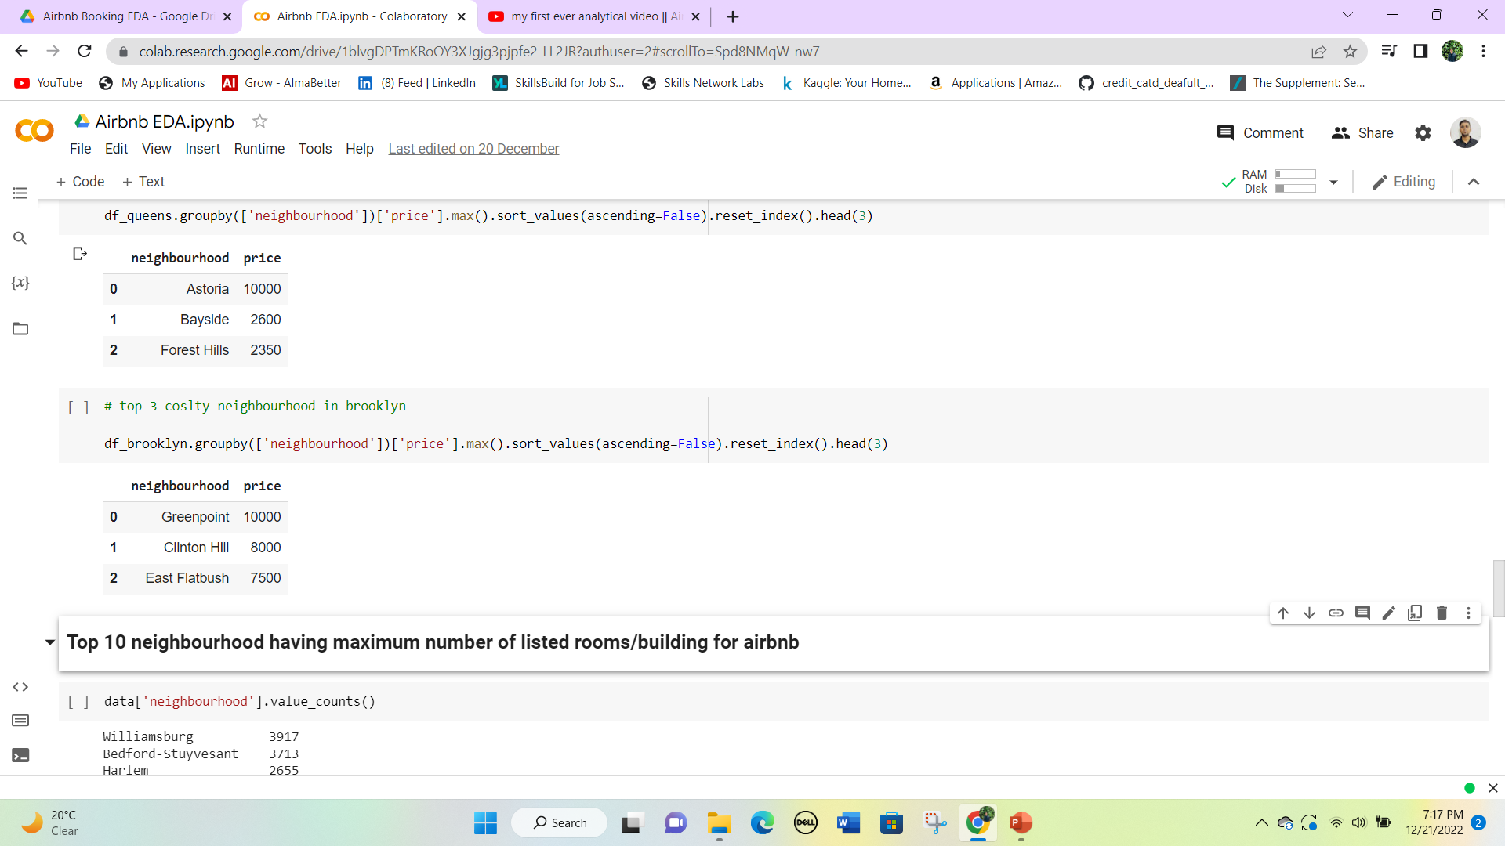
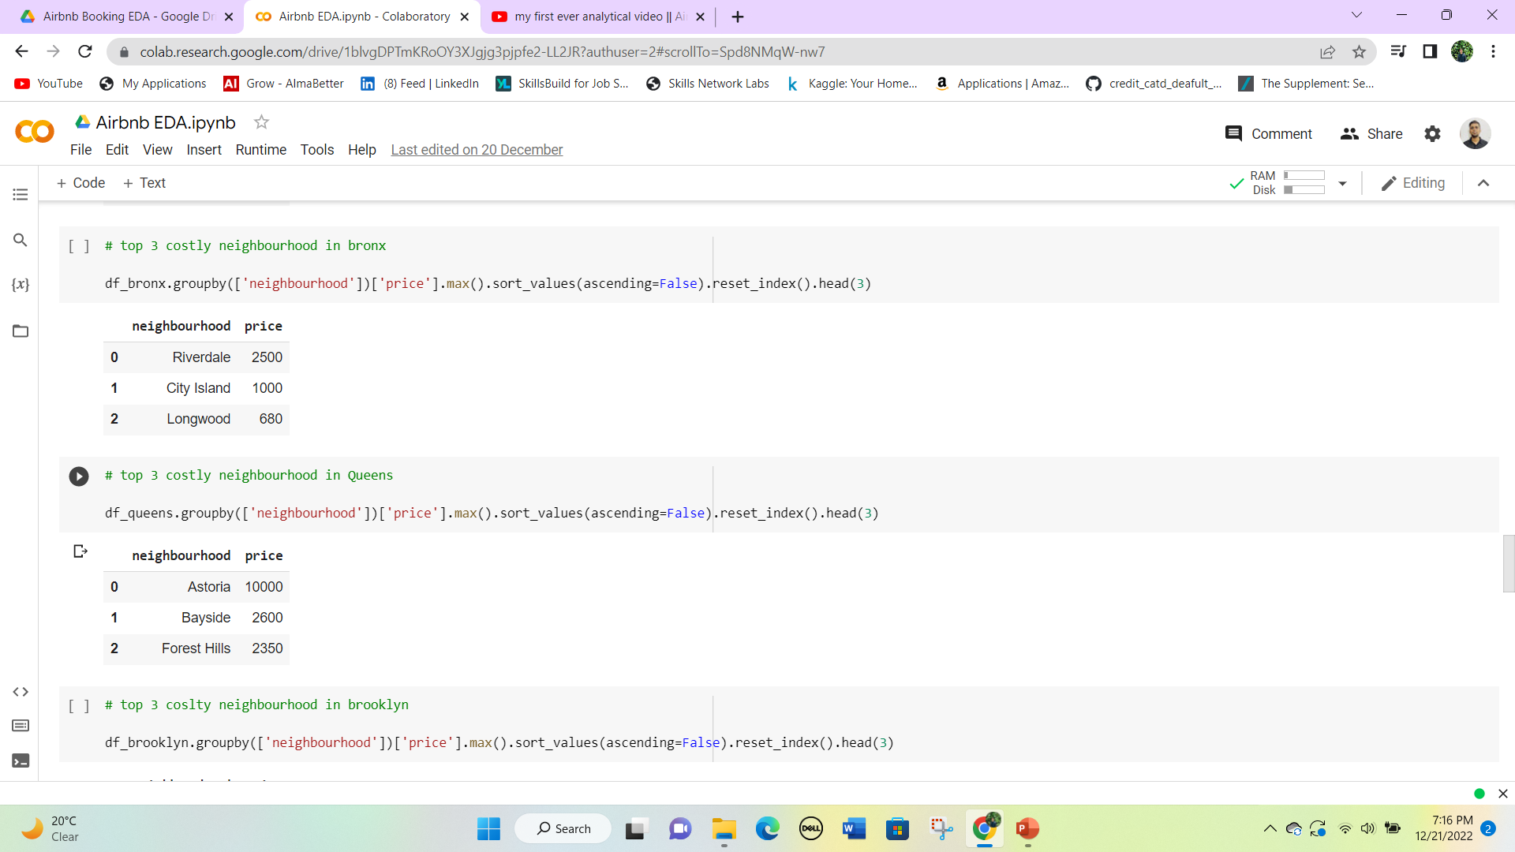
Top 3 costly neighbourhoods in each neighbourhood_group.
Manhattan
Manhattan is the most costly neighbourhood group and there is no difference in the three costly neighbourhoods.
Staten
Staten neighbourhood group has a very high difference in cost of the top 3 neighbourhood.
Brooklyn
Brooklyn is the second most expensive neighbourhood group but it has also the same maximum price as Manhattan
Queens
Astoria is the only expensive neighbourhood in Queens. The second neighbourhood has the almost one-third price as of Astoria.
Bronx
The Bronx is the cheapest neighbourhood group. All the neighbourhood is also a little less expensive.

Slide 30
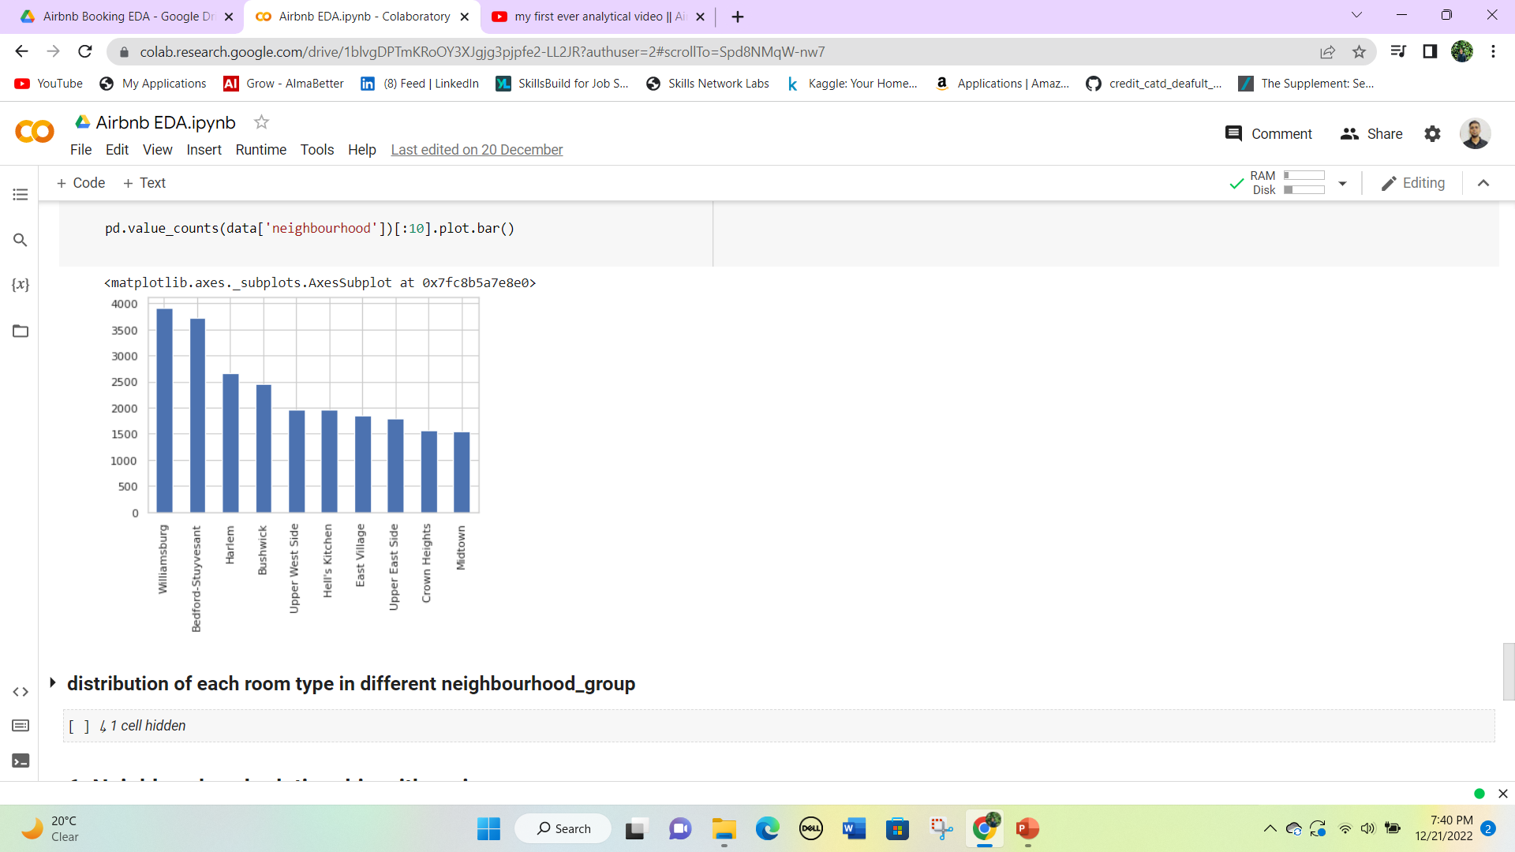
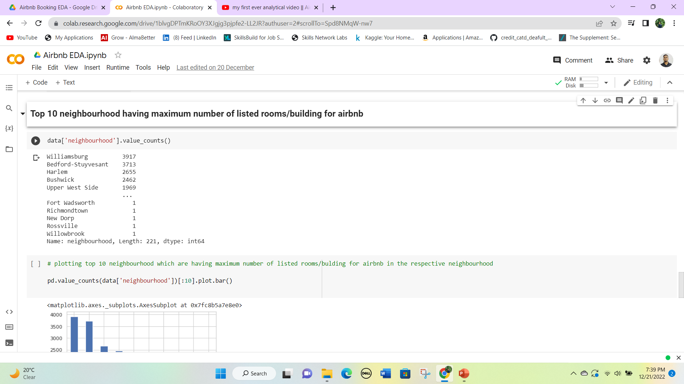
Top 10 neighbourhoods which have the maximum number of listed rooms/buildings on Airbnb.
The maximum listed buildings are in the Williamsburg neighbourhood.
Williamsburg is in the Manhattan neighbourhood group which has the most number of listing among the different neighbourhood groups.

Slide 31
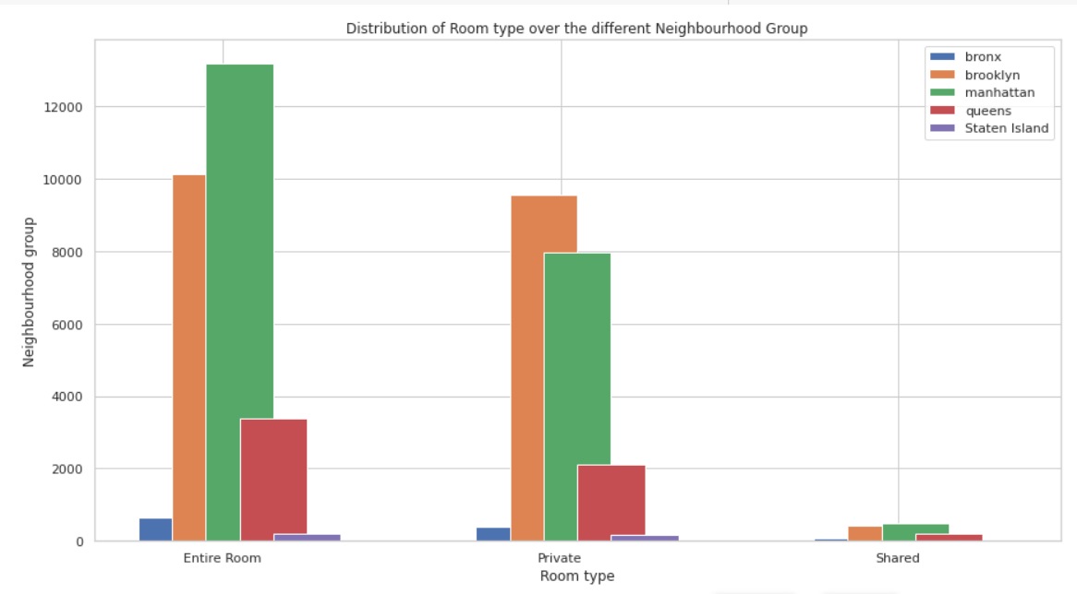
Distribution of each room type in different neighbourhood_group
Brooklyn has an almost similar number of Entire rooms and Private rooms listed on Airbnb.
But Manhattan has differences in the room type.
Observation: people in Manhattan prefer entire rooms while in Brooklyn room type does not affect the number of booking

Slide 32
6. Reviews Analysis
Well, reviews are the key indicator of the real value of a service, Most of the time people prefer rooms with high ratings and good reviews because it gives an idea of the service or stays at the hotels.
So we will be answering some questions related to reviews:
Top 10 Neighbourhood with the highest number of reviews per month
Top 10 Neighbourhood having the highest total number of reviews

Slide 33
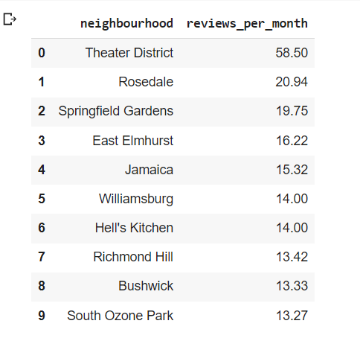
Top 10 Neighbourhood with the highest number of reviews per month
Theater District has the highest reviews per month.
In the previous analysis we found that Williamsburg has the most number of the listed building and it is also in this list.
It means that the buildings in the Williamsburg neighbourhood give the best services to its customer.

Slide 34
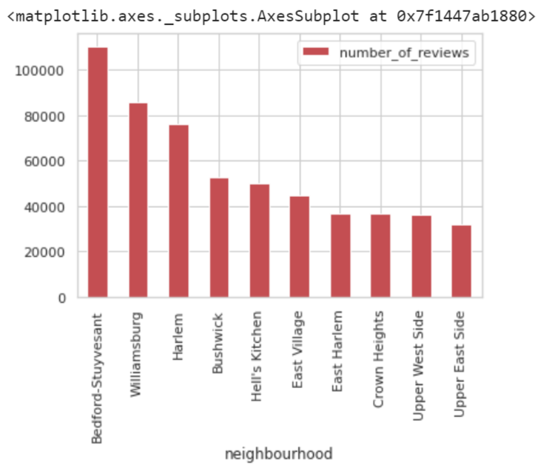
Top 10 Neighbourhood having the highest total number of reviews
We can see here also Williamsburg has the second most total number of reviews received on Airbnb by customers.
Bedford-Stuyvesant has the most total number of reviews on Airbnb, which means that the price in this neighbourhood is feasible and Customers are happy with their stays.

Slide 35
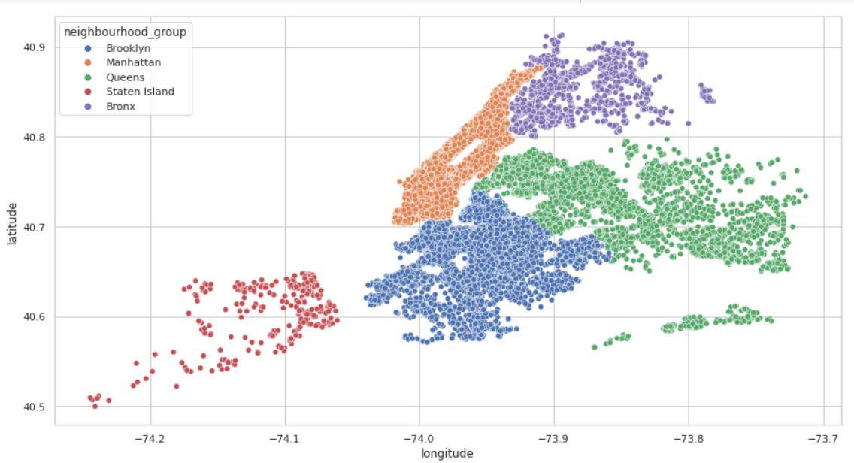
7. Location and Room type Analysis
First, let’s visualize all the neighbourhoods on the actual map using the latitudes and longitudes of all the neighbourhoods.
Manhattan and Brooklyn can be seen most dense areas on the map due to the highest number of listings.
Staten island has very few listings and is far from each other.

Slide 36
Conclusion
Exploratory Data Analysis comes in handy whenever a data scientist needs to gain new insights into a massive quantity of data sets.
In this aspect, EDA can be beneficial for fields such as research and development, engineering, and data science. Hence, In today’s age, with access to advanced computing power along with the support of modern analytics.
EDA can be a stimulating and engaging experience for researchers or data scientists to explore unexpected value in a massive quantity of complex data sets.

